Slide 1

Notes:
Youth opportunities is a topic which interests everybody and which you can easily talk about in the classroom.

Slide 2
Objectives/messages
1. Solidarity and the European Solidarity Corps
2. Erasmus+ opportunities/30 years of E+
3. Participation and shaping together youth policy

Slide 3
Diary note
To present the Youth Week and its aims in a coherent way
Text can be used for communication materials you are producing
EC will provide translated versions

Slide 4


Visual branding

Slide 5


Slide 6




Slide 7




Slide 8
Slogan
Translation workflow

Slide 9
Infographics
Editable infographics to complement the diary note (you can translate and edit)
Generic data on the youth sector
Most popular EVS sending and receiving countries, inclusion aspect, number of participants etc

Slide 10
Change Makers
Inspiring people – "movers and shakers"
Erasmus+ has triggered or contributed to the change in society
1 per country to film less than 1 min long video in their native language with subtitles in English
Promoted before, during and after EYW2017 on social media and websites

Slide 11
Brussels based events programme
1-2 May Video shooting and editing workshop: 16 participants
All proposed change-makers will have an opportunity to apply.
3-4 May Stakeholders' conference: 350 participants
National authorities, experts, NAs, youth organisations, national youth councils, researchers, young people, "2nd and 3rd change-maker"

Slide 12
4 May Celebratory Event 380+ participants
To showcase stories of change-makers and celebrate EYW2017
3-4-5 May A programme for change-makers
Training on TED like speaking, visiting the EP, meeting high level officials, participation in celebratory event

Slide 13
Side events
6 May Open days of the European Commission
Possible participation of some change-makers in EAC stand
Tbc 2 May Public event organised by Eurodesk Brussels and the European Youth Forum

Slide 14
Idea labs ahead of stakeholders' meeting
Get in touch with your National Youth Council and Youth Ministries
What are the main challenges which young people face today?
Key discussion items: Climate change, geographic mobility, youth unemployment, democratic participation
How can EU Youth policy help and with which tools
Input directly and through delegates

Slide 15
Website and social media
Youthweek.eu that is redirected to http://ec.europa.eu/youth/week
4 main parts: About EYW2017, videos, events, common activity
Anyone can encode a EYW2017 event!
Social media: Erasmus+, European Youth and your channels

Slide 16

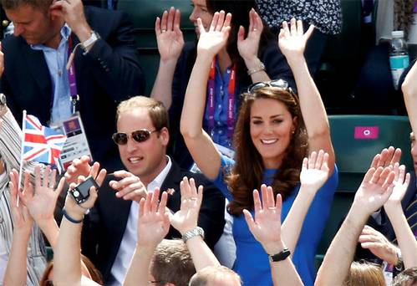
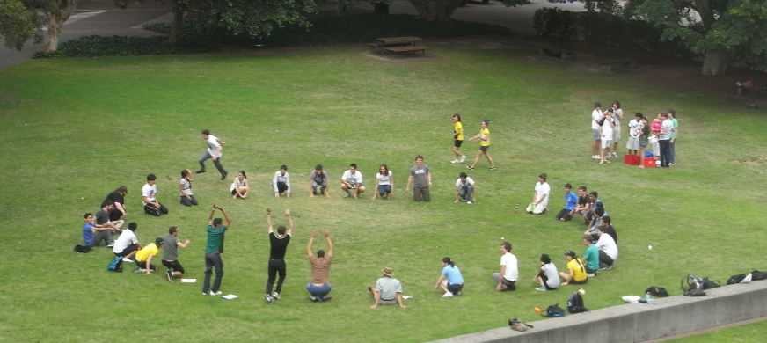
Common activity

Slide 17
The wave for solidarity
Organise during your events
Film it
Send it to us
One video of the wave across Europe
Off-line and online wave!

